Slide 1

Claims, communications & set-up provider survey results │ feb 28, 2020
This survey summarizes the experience of reporting CBH members. CBH has gathered additional detail about reported problems and will make it available to Optum to address individual provider issues.
However, the extent of these providers’ problems – after focused efforts to address and elevated attention – may reflect barriers that are equally or more widespread in the provider community as a whole.
Thus we encourage Optum and MDH to come up with strategies to identify, communicate and resolve the issues flagged herein among the provider community as a whole.

Slide 2
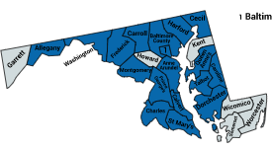
survey resPONDENTS │ feb 28, 2020
20 CBH members completed survey between Feb 20-27.
  Respondents’ annual revenue varies from < $500k to over $80M annually.
  Respondents provide services in 18 of Maryland’s 24 jurisdictions
Respondents offer following PBHS services:
  Outpatient mental health clinic (OMHC)
  Psychiatric rehabilitation program (PRP)
  Residential rehabilitation program (RRP)
  Targeted case management (TCM)
  Supported Employment/Vocational rehabilitation
  Residential crisis services
  1915(i)
  Mobile treatment services/Assertive Community Treatment (ACT)
  Outpatient SUD: Level 1, Level 2, and MAT
  Respite care
  Baltimore City capitation program
  Health homes
  TBS

Slide 3
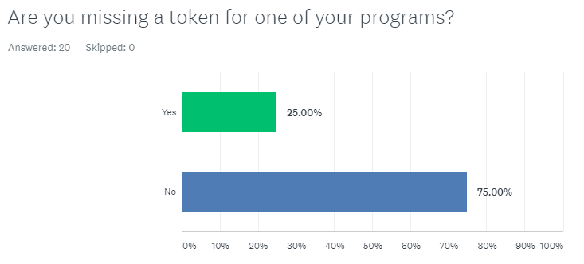
Provider Set-up
25% of respondents are missing tokens.
100% of missing tokens are supported employment.
Some received tokens subsequent to survey, but a portion of those were not working.

Slide 4
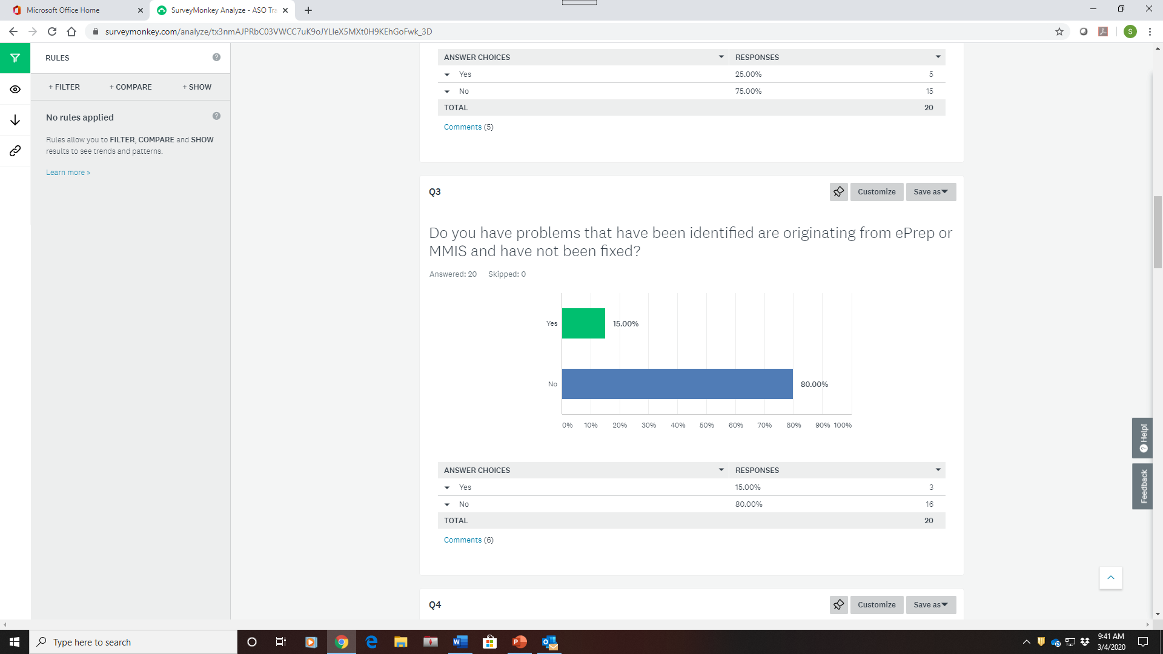
Provider Set-up
15% have ePrep or MMIS problems.

Slide 5
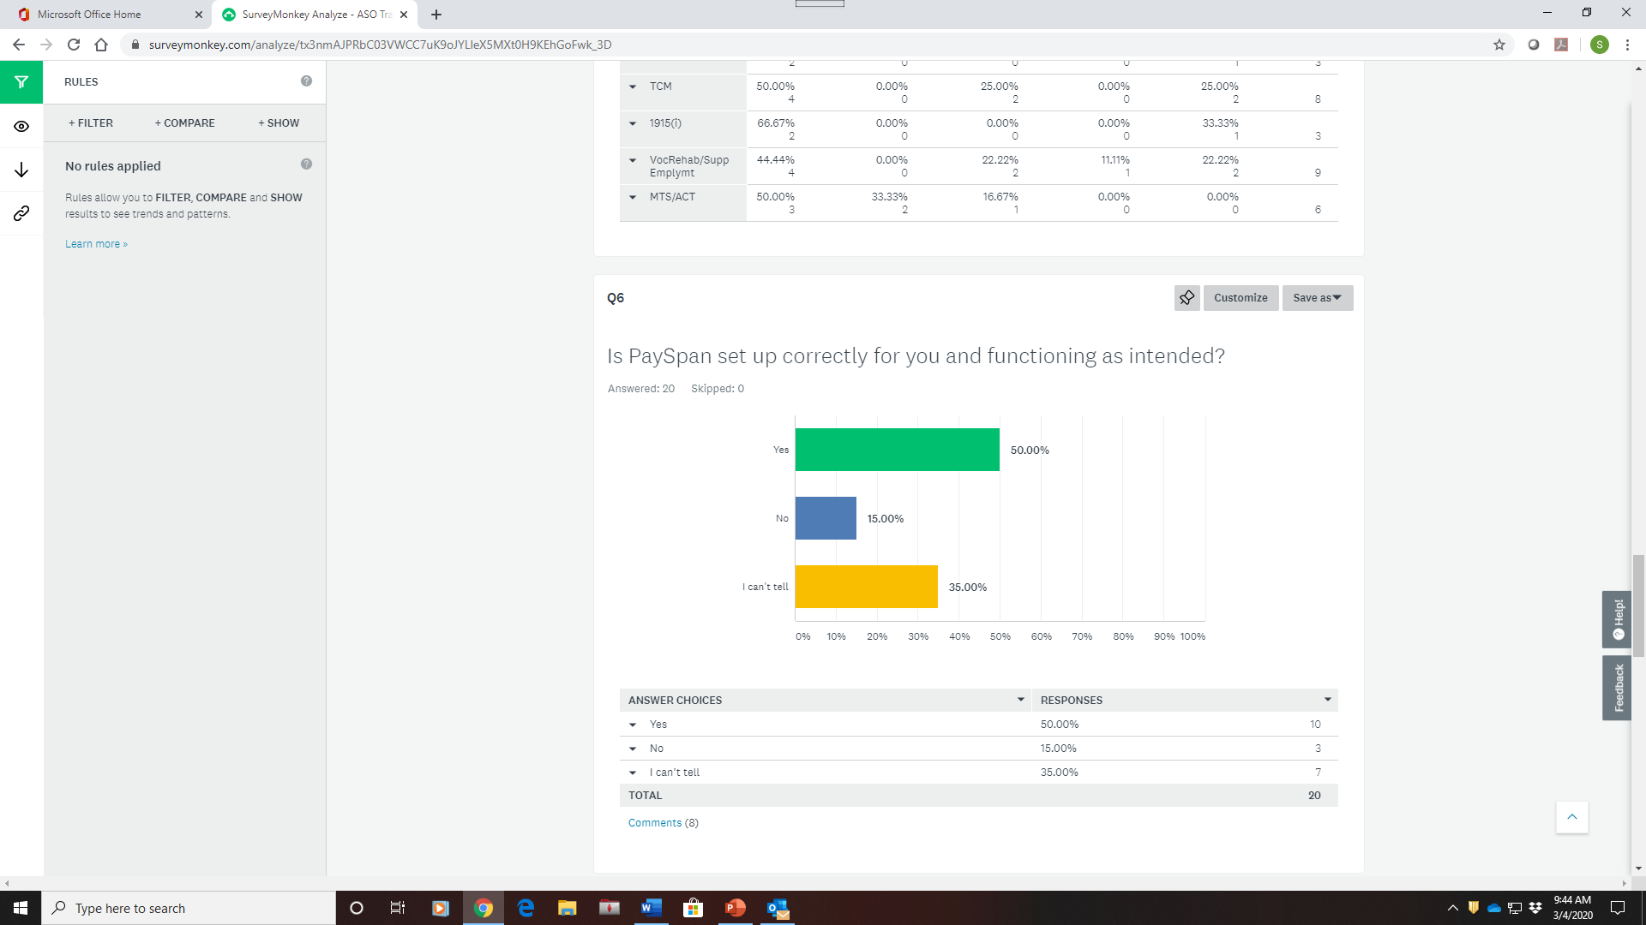
Provider Set-up
Over one-third of respondents don’t have sufficient information to evaluate whether PaySpan is set up correctly.
15% indicate that it is not set up correctly for their organizations.

Slide 6
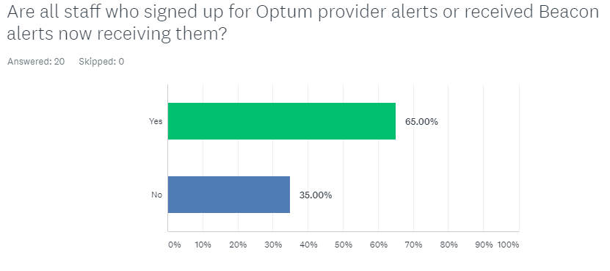
Provider Communications
35% report that not all needed staff are getting provider alerts.

Slide 7
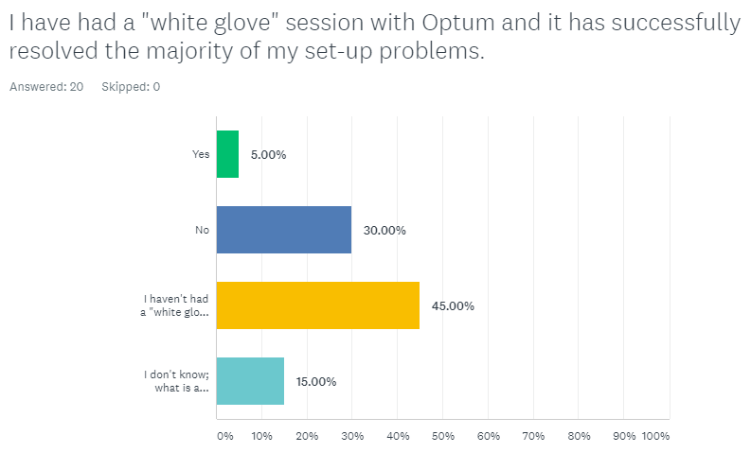
Provider Communications
Only 5% of respondents found individual “white glove” sessions successful
Individual sessions to resolve providers’ set-up problems have either not been effective or not adequately communicated.

Slide 8
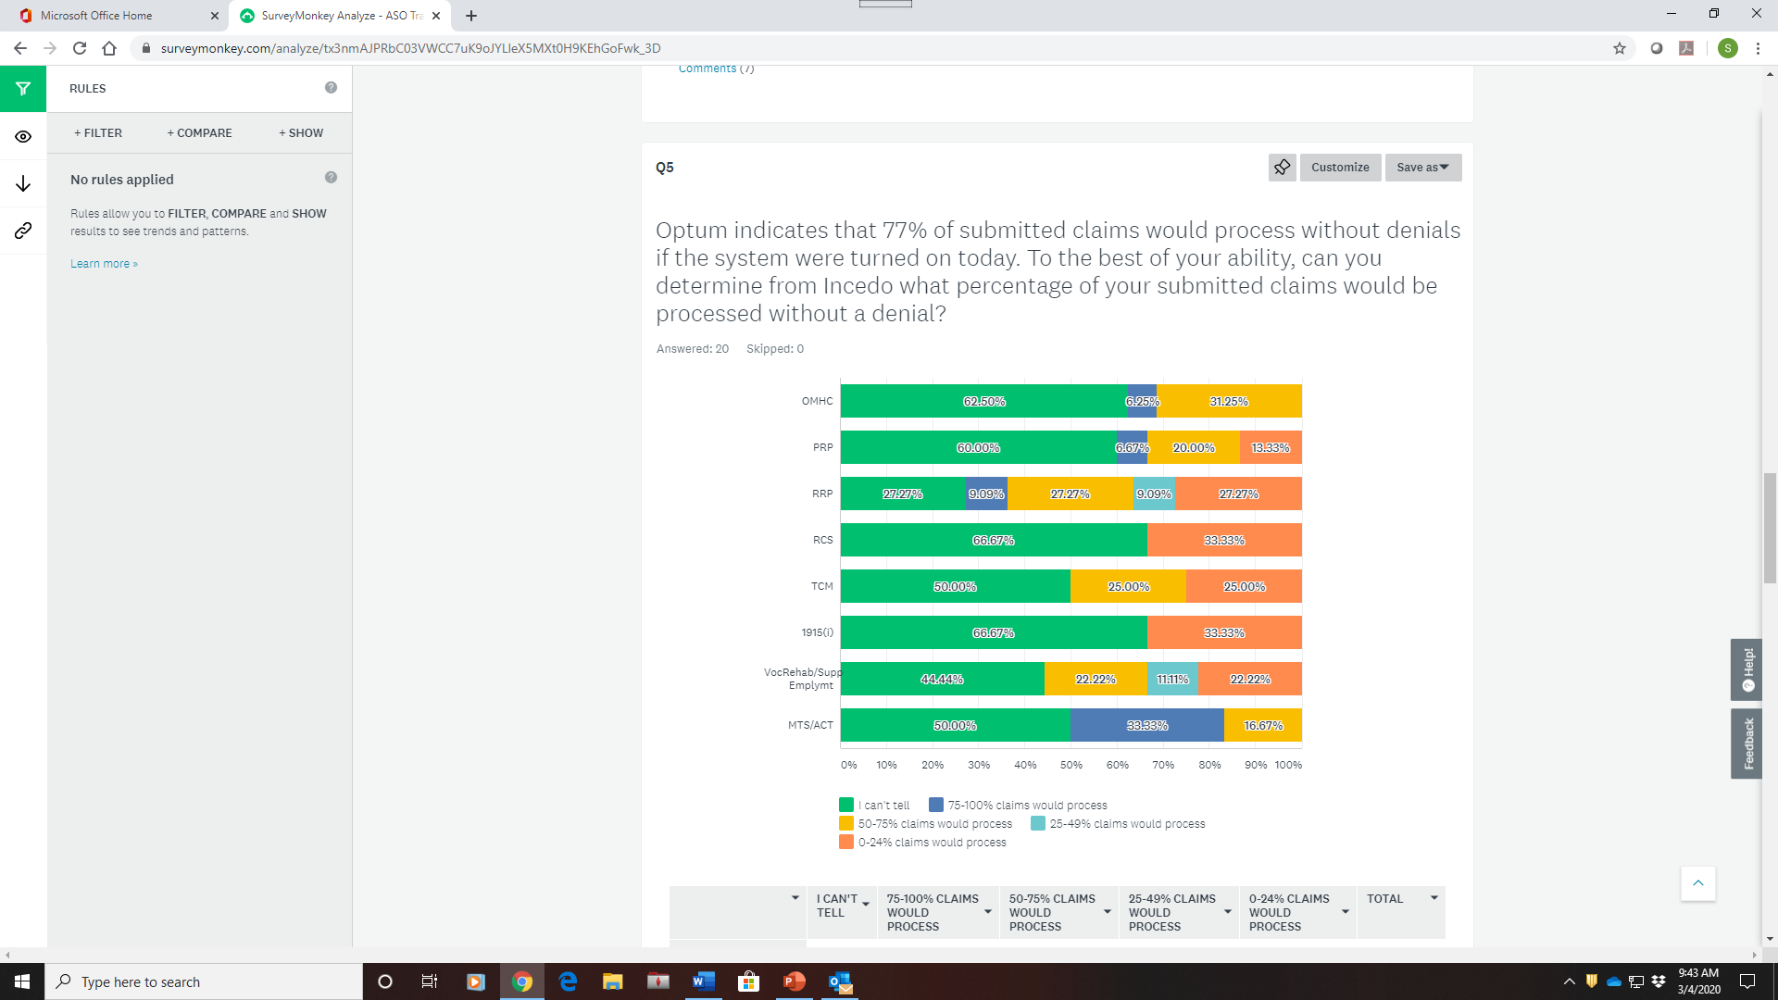
Claims Processing
Provider confidence in claims processing varies significantly by program.
Lack of confidence is concentrated in: residential crisis, 1915(i), RRP and targeted case management
Survey excluded: outpatient SUD, respite, capitation

Slide 9
Claims Processing │ What Capabilities are missing?
We need to be able to upload 277 files showing adjudicated claims with any error codes on denied claims.
We need the 835 files to show what has been paid. Without these it is difficult to keep track of amount paid and for which client service.
The list can be filtered, but not by CPT code or by service type. To research the answers to this survey I just had to scroll through hundreds of claims and manually compile information to get a sense of how the claims system is working.
Exporting/Printing of data - esp claims, is a must. We are reduced to having to copy and paste screens into excel to be able to "track" what is happening inside Incedo.
Ability to query out reports and export or print them. No reporting mechanism that I can find. Denial codes or reasons More streamlined workflow when looking for claims.
When you hover over the information icons, nothing displays. What does the status "multiple" mean? The system is not robust enough to provide the necessary information needed to properly track claims.
Under claims, service date, treat date and date received lingo is unclear for descriptions of what they mean. Under each line item, date paid needs to be shown versus having to scroll over to date paid. Reasons for denial are not shown;
Need to be able to correct and void claims and manually enter a secondary claim and upload associated EOBs.
We need a reporting feature to audit our H2016 services processed by Optum prior to us submitting our H2018 services so they don't cascade when they shouldn’t
Incedo is not accepting telehealth claims. All our telehealth claims are being denied. Per the claims department, there is a glitch in Incedo that is rejecting all telehealth claims. Contact provider relation on January 7,15 and February 5,2020, still waiting for this issue to be fixed.

Slide 10
Claims Processing │ What Barriers remain?
We have batches that are not being received by OPTUM
I have uploaded the claim batches but have not received 999s. When I check for any claims in the filter, there are only about 10 there from the batches I have submitted to optum. 1. Need verification of why they are denied 2. Records of claims that are accepted 3. Any report!
1. Proper editing of claims prior to forwarding into adjudication. 2. proper validation of claim batches; 3. The data from the claims view screen is inaccurate (incorrect denials, incorrect claim status, incorrect amounts paid). 4. Optum staff are not helpful in resolving issues, answers are inconsistent; 5.Changes made to claims processing and auth service codes are not communicated.
Incedo screens only allow 500 claims and we bill about 17k claims per month so there is no way to know what percentage without an eob/835.
“Pay to” address are all the same. It would be helpful if they had the last four digits of the NPI number when entering claims online so that the provider knows they selected the correct “pay to” address for that claim.
OMHC combination rules allow two visit per day. It’s a hit-or-miss when visits are being processed in Incedo. Some ITTP and Therapy visit are being processed and approved for the day. Some are being denied for only one visit on allow.
Optum/state are making the same mistake they made with the initial transition: claiming without presenting evidence that the system is working and wanting to go live without providers having a chance to test and report back. I have no remittances, 835s, or 277s to review to see if the claims processing is working. Checking claims at random in Incedo shows thousands of claims that are denied without denial reason. Some have approved amounts and some don't. Other claims show as approved at the claim level but denied at the service line level or vice versa. I don't know how to interpret this hence the answer's of "can't tell" above.

Slide 11
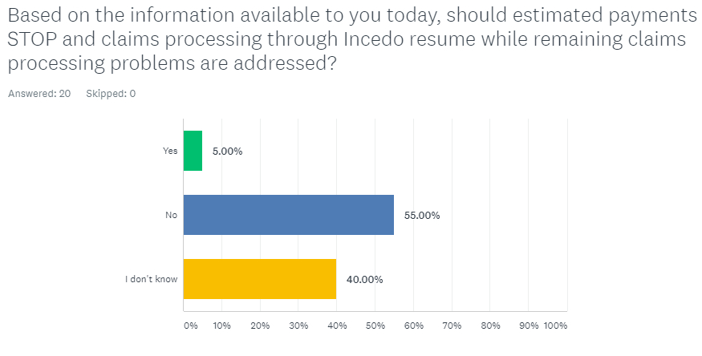
Claims Processing
95% of providers do not support re-starting claims processing at current time.

Slide 12
Proposed Debugging Committee functions
Identify recurring problem across multiple providers
Test resolution & communications with sample of providers
Modify resolution & comms based on test results
Expand resolution & comms to providers as a whole
Evaluate results & determine next steps, if any
Weekly meeting of provider associations, MDH and Optum representatives.
Goal to create a closed feedback loop with the provider community to effectively identify, resolve, and communicate about the ASO implementation.

