Slide 1
Optum Transition Update
House Health and Government Operations Committee
House Appropriations (Health and Social Services Subcmte.)
Senate Budget & Taxation Committee
Senate Finance Committee
Robert R. Neall, Health Secretary
Chad Burkholder, Chief Operating Officer, Optum Behavioral Health
Dennis R. Schrader, MDH Chief Operating Officer and Medicaid Director
Dr. Aliya Jones, Deputy Secretary of Behavioral Health
Tuesday, November 17, 2020
Thursday, November 19, 2020

Slide 2
Summary
As directed by the General Assembly, the Maryland Department of Health (MDH) transitioned from a grants-based behavioral health (BH) financing model to a fee-for-service financing model for the appx. 2,200 registered providers in 2017-18. The Optum transition started Jan. 1, 2020.
MDH is working with our Optum Maryland partners to ensure:
200,000 Maryland Medicaid beneficiaries receive clinically appropriate needed behavioral health services;
Provider payment system operational performance;
Providers are reimbursed for authorized services provided; and
That over and under-payments to providers made during 1st Half 2020 estimated payments are reconciled by the end of the fiscal year.
Notes:
Sec Neall

Slide 3
Optum has paid providers $453 million since relaunch of actual payments (Aug. 13, 2020)
Notes:
Chad

Slide 4
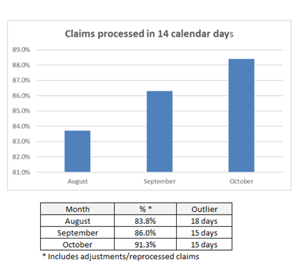
The majority of claims are processed within 14 calendar days
Notes:
Chad

Slide 5
Claims denial rate is currently 16%
Top 5 Denial Reasons :
Authorization is not on file
Invalid Level of Care, Modifier, or Place of service billed
Claim billed under incorrect provider type
Participant eligibility not effective
Service Payable by other Primary Carrier

Slide 6
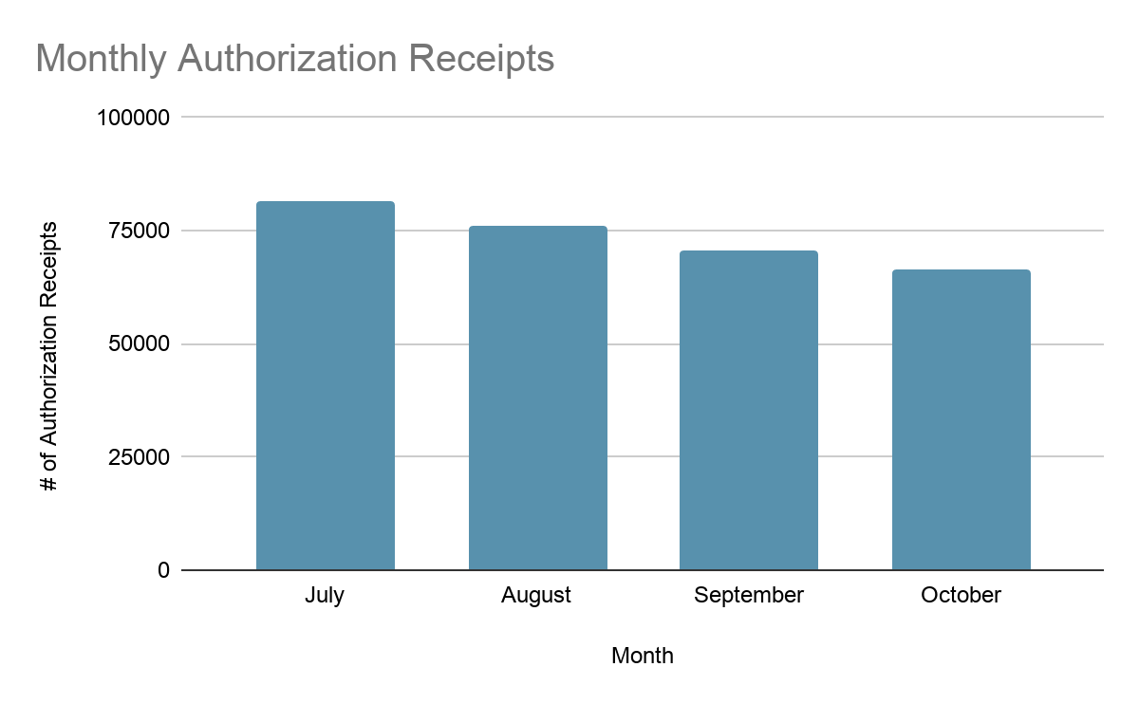
Optum is processing authorizations and supporting timely care for Marylanders
97.8% of authorizations have been successfully submitted and processed through the system
81,542
76,202
70,593
66,448

Slide 7
Providers may owe the State up to
$163 million from estimated payments
Amount providers may owe to MDH
Total MDH estimated payments
Total payments in authorized claims
=
-
=
$1.06
billion
(total estimated payments by MDH)
$894
million
(total paid for authorized claims)
-
$163 million
(what providers may owe MDH)
Notes:
Dennis

Slide 8
Timeline for Assisted Reconciliation
November: Release all remaining key reconciliation documents.
December through May 2021: MDH and Optum work closely with providers to reconcile payments.
June 2021: Collaborate with providers to develop a recoupment process.
Notes:
Dennis

Slide 9
Next Steps in the Optum Transition
Make sure that 200,000 Marylanders continue to receive clinically appropriate behavioral health services.
Ensure that providers and their concerns are heard by continuing weekly provider forums and that their billing staff are connected to responsive Optum counterparts.
Continue strengthening Optum provider customer service and system performance.
Develop and implement service quality and system of care improvement measures.
Notes:
Dr. Jones

